Slide 1
LSTM and GRU

Slide 2
Agenda
What is RNN? and How it’s develop to become LSTM and GRU?
Propose of using LSTM and GRU?
How GRU Cell work
How LSTM Cell work
How to use those cells?

Slide 3
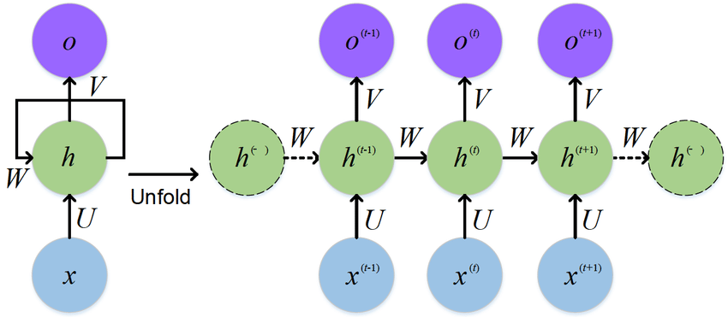
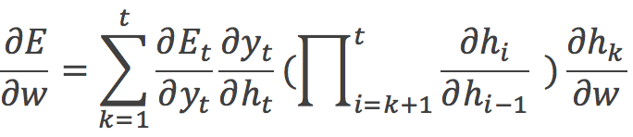
What is Recurrent neural network?
Idea : Some Input impact future prediction vice versa.
Application : Speech Recognition, Handwriting Recognition etc.
Problem :
In long sequence of RNN vanishing gradient is commonly found
Gradient Equation

Slide 4
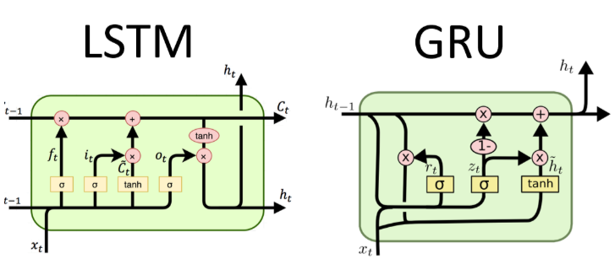
Improvement of rnn
So here we go : LSTM and GRU is based on RNN idea with a tweak in some concept

Slide 5
Propose of lstm and gru
RNN vanishing gradient result in the memory can not be transfer from too far past cells. LSTM and GRU adding gate which like a highway to those memories.

Slide 6
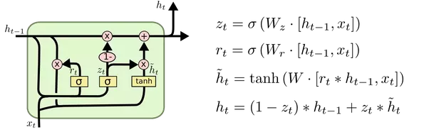
GRU Cell
Modify memory ideas:
Which value to update h_{t} ? → h_{t}~ Should we use h_{t-1}→ r_{t}
How to update ? → z_{t}

Slide 7
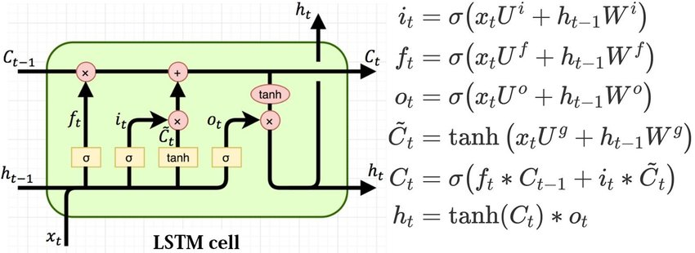
LSTM
Action:
Forget → Should we clear previous cell state(Forget Gate f_{t})
Write → 1.) Should we update cell state (Input gate i_{t}) 2.) value to update(Input modulation Gate C_{t}~)
Read → Allow h_{t+1} to read h_{t}(Output Gate o_{t})

Slide 8
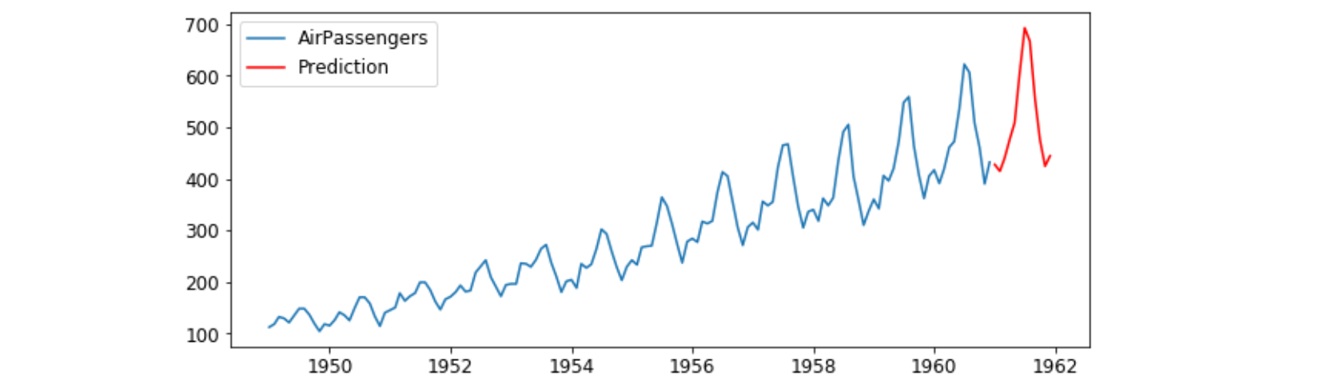
Use case : Time series prediction(1)

Slide 9
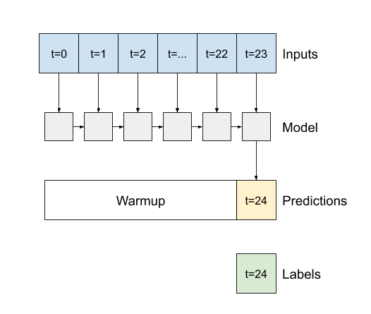
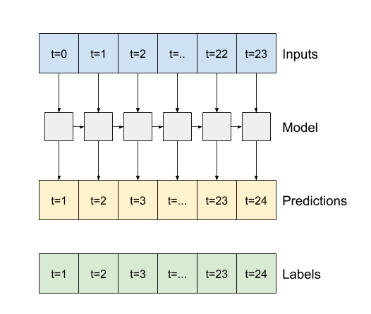
Use case : Time series prediction(2)

